Slide 1
CS2040S Tutorial 9
Done by Xiao Yan

Slide 2
Today’s tutorial
Content recap (Adjacency list vs matrix, DFS BFS)
Tutorial questions

Slide 3
Graph representation

Slide 4
Graph Representation
What is a Graph?

Slide 5
Graph Representation
What is a Graph?
Graph consists of:
V, a set of nodes/vertices
E, a set of edges

Slide 6
Graph Representation
What is a Graph?
Graph consists of:
V, a set of nodes/vertices
E, a set of edges
How do you represent Graphs in a program?

Slide 7
Graph Representation
What is a Graph?
Graph consists of:
V, a set of nodes/vertices
E, a set of edges
How do you represent Graphs in a program?
Adjacency List
Adjacency Matrix
Edge List (may not have been gone through in lecture!)

Slide 8
Adjacency List (Undirected Graph)
Adapted from CLRS
How to represent this?
1
2
3
5
4

Slide 9
Adjacency List (Undirected Graph)
Adapted from CLRS
How to represent this? Array: The nodes
1
1
2
2
3
3
5
4
4
5

Slide 10
Adjacency List (Undirected Graph)
Adapted from CLRS
How to represent this? Array: The nodes Linked List: The edges representing the other nodes it is connected to
1
2
5
1
2
2
3
1
4
5
3
3
4
2
5
4
4
2
5
3
5
1
2
4

Slide 11
Adjacency List (Undirected Graph)
Adapted from CLRS
How to represent this? Array: The nodes Linked List: The edges representing the other nodes it is connected to
1
2
5
1
2
2
3
1
4
5
3
3
4
2
5
4
4
2
5
3
5
1
2
4

Slide 12
Adjacency List (Undirected Graph)
Adapted from CLRS
How to represent this? Array: The nodes Linked List: The edges representing the other nodes it is connected to
1
2
5
1
2
2
3
1
4
5
3
3
4
2
5
4
4
2
5
3
5
1
2
4

Slide 13
Adjacency List (Undirected Graph)
Adapted from CLRS
How to represent this? Array: The nodes Linked List: The edges representing the other nodes it is connected to
1
2
5
1
2
2
3
1
4
5
3
3
4
2
5
4
4
2
5
3
5
1
2
4

Slide 14
Adjacency Matrix (Undirected Graph)
Adapted from CLRS
How to represent this?
1
2
3
5
4

Slide 15
Adjacency Matrix (Undirected Graph)
Adapted from CLRS
How to represent this? Matrix A: A[u][v] == 1 iff (u, v) ∈ E
1
2
3
4
5
1
2
1
0
1
0
0
1
2
1
0
1
1
1
3
3
0
1
0
1
0
5
4
4
0
1
1
0
1
5
1
1
0
1
0

Slide 16
Adjacency Matrix (Undirected Graph)
Adapted from CLRS
How to represent this? Matrix A: A[u][v] == 1 iff (u, v) ∈ E
1
2
3
4
5
1
2
1
0
1
0
0
1
2
1
0
1
1
1
3
3
0
1
0
1
0
5
4
4
0
1
1
0
1
5
1
1
0
1
0

Slide 17
Adjacency Matrix (Undirected Graph)
Adapted from CLRS
How to represent this? Matrix A: A[u][v] == 1 iff (u, v) ∈ E
1
2
3
4
5
1
2
1
0
1
0
0
1
2
1
0
1
1
1
3
3
0
1
0
1
0
5
4
4
0
1
1
0
1
5
1
1
0
1
0

Slide 18
Adjacency Matrix (Undirected Graph)
Adapted from CLRS
How to represent this? Matrix A: A[u][v] == 1 iff (u, v) ∈ E
1
2
3
4
5
1
2
1
0
1
0
0
1
2
1
0
1
1
1
3
3
0
1
0
1
0
5
4
4
0
1
1
0
1
5
1
1
0
1
0

Slide 19
Adjacency List (Directed Graph)
Adapted from CLRS
How to represent this? Array: The nodes Linked List: The edges representing the other nodes it is connected to
1
1
2
2
3
3
5
4
4
5

Slide 20
Adjacency List (Directed Graph)
Adapted from CLRS
How to represent this? Array: The nodes Linked List: The edges representing the other nodes it is connected to
1
2
5
1
2
2
3
3
2
5
4
4
3
2
5
4
2

Slide 21
Adjacency List (Directed Graph)
Adapted from CLRS
How to represent this? Array: The nodes Linked List: The edges representing the other nodes it is connected to
1
2
5
1
2
2
3
3
2
5
4
4
3
2
5
4
2

Slide 22
Adjacency List (Directed Graph)
Adapted from CLRS
How to represent this? Array: The nodes Linked List: The edges representing the other nodes it is connected to
1
2
5
1
2
2
3
3
2
5
4
4
3
2
5
4
2

Slide 23
Adjacency List (Directed Graph)
Adapted from CLRS
How to represent this? Array: The nodes Linked List: The edges representing the other nodes it is connected to
1
2
5
1
2
2
3
3
2
5
4
4
3
2
5
4
2

Slide 24
Adjacency Matrix (Directed Graph)
Adapted from CLRS
How to represent this?
1
2
3
5
4

Slide 25
Adjacency Matrix (Directed Graph)
Adapted from CLRS
How to represent this? Matrix A: A[u][v] == 1 iff (u, v) ∈ E Note: (u, v) is different from (v, u) if edges are directed
1
2
3
4
5
1
2
1
0
1
0
0
1
2
0
0
0
0
0
3
3
0
1
0
0
0
5
4
4
0
1
1
0
0
5
0
1
0
1
0

Slide 26
Adjacency Matrix (Directed Graph)
Adapted from CLRS
How to represent this? Matrix A: A[u][v] == 1 iff (u, v) ∈ E Note: (u, v) is different from (v, u) if edges are directed
1
2
3
4
5
1
2
1
0
1
0
0
1
2
0
0
0
0
0
3
3
0
1
0
0
0
5
4
4
0
1
1
0
0
5
0
1
0
1
0

Slide 27
Adjacency Matrix (Directed Graph)
Adapted from CLRS
How to represent this? Matrix A: A[u][v] == 1 iff (u, v) ∈ E Note: (u, v) is different from (v, u) if edges are directed
1
2
3
4
5
1
2
1
0
1
0
0
1
2
0
0
0
0
0
3
3
0
1
0
0
0
5
4
4
0
1
1
0
0
5
0
1
0
1
0

Slide 28
Adjacency Matrix (Directed Graph)
Adapted from CLRS
How to represent this? Matrix A: A[u][v] == 1 iff (u, v) ∈ E Note: (u, v) is different from (v, u) if edges are directed
1
2
3
4
5
1
2
1
0
1
0
0
1
2
0
0
0
0
0
3
3
0
1
0
0
0
5
4
4
0
1
1
0
0
5
0
1
0
1
0

Slide 29
Graph Representations
Space complexity?
1
1
2
3
4
5
2
5
1
2
1
0
1
0
0
1
2
3
1
4
5
2
1
0
1
1
1
3
3
4
2
3
0
1
0
1
0
5
4
4
0
1
1
0
1
4
2
5
3
5
1
1
0
1
0
5
1
2
4

Slide 30
Graph Representations
Space complexity?
O(V + E)
O(V²)
1
1
2
3
4
5
2
5
1
2
1
0
1
0
0
1
2
3
1
4
5
2
1
0
1
1
1
3
3
4
2
3
0
1
0
1
0
5
4
4
0
1
1
0
1
4
2
5
3
5
1
1
0
1
0
5
1
2
4

Slide 31
Graph Representations
Space complexity?
O(V + E) => O(V^2) for complete graph
O(V²)
1
1
2
3
4
5
2
5
1
2
1
0
1
0
0
1
2
3
1
4
5
2
1
0
1
1
1
3
3
4
2
3
0
1
0
1
0
5
4
4
0
1
1
0
1
4
2
5
3
5
1
1
0
1
0
5
1
2
4

Slide 32
Graph traversal
BFS/DFS

Slide 33
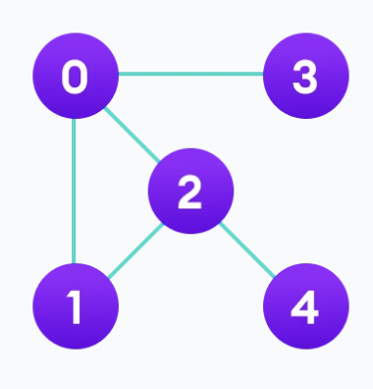
BFS

Slide 34
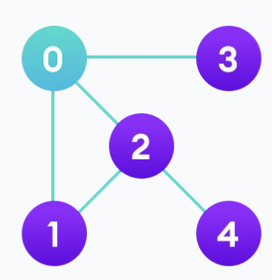
BFS

Slide 35
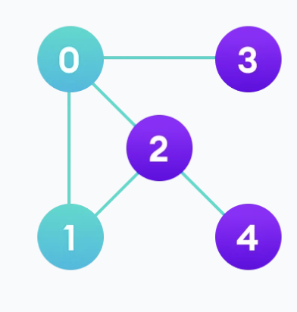
BFS

Slide 36
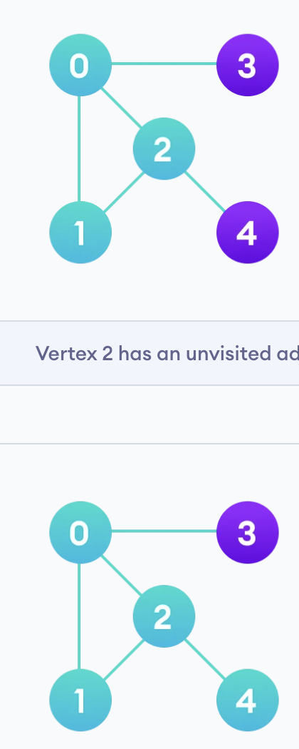
BFS

Slide 37
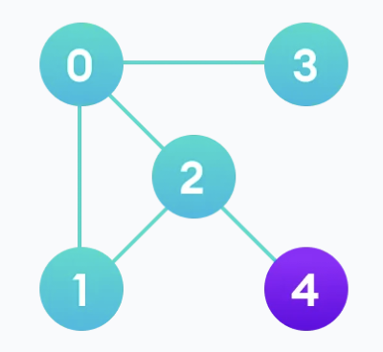
BFS

Slide 38
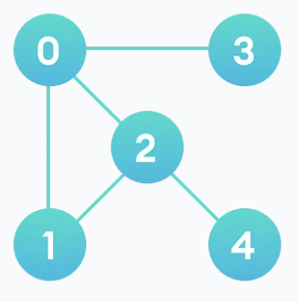
BFS

Slide 39
DFS

Slide 40
DFS

Slide 41
DFS

Slide 42
DFS

Slide 43
DFS

Slide 44
DFS

Slide 45
Tutorial

Slide 46
Problem 1a
Recall that when performing DFS or BFS, we may keep track of a parent pointer
that indicates the very first time that a node was visited. Explain why these parent edges form a tree (i.e., why there are no cycles).

Slide 47
Problem 1a
Recall that when performing DFS or BFS, we may keep track of a parent pointer that indicates the very first time that a node was visited. Explain why these parent edges form a tree (i.e., why there are no cycles).
Node and edge is only added when the node is visited for the first time
A total of n new nodes will be discovered starting from source node
Because each node discovered can only have 1 parent pointer, you will get n-1 parent pointers
Therefore as you have n nodes and n-1 edges, it is a tree
Known as BFS/DFS-spanning tree.

Slide 48
Problem 1b
How does DFS or BFS on a tree relate to DFS or BFS on a graph? Are they the same algorithm?
Trees are a type of graph. BFS/DFS for graphs are generalized version and will work for trees.

Slide 49
Problem 1b
How does DFS or BFS on a tree relate to DFS or BFS on a graph? Are they the same algorithm?
Trees are a type of graph. BFS/DFS for graphs are generalized version and will work for trees.
For the tree version of BFS/DFS, we did not keep track of visited nodes, why?

Slide 50
Problem 1b
How does DFS or BFS on a tree relate to DFS or BFS on a graph? Are they the same algorithm?
Trees are a type of graph. BFS/DFS for graphs are generalized version and will work for trees.
For the tree version of BFS/DFS, we did not keep track of visited nodes, why?
Trees are guaranteed to not have a cycle! No need to keep track of visited since its impossible to visit a node twice. (edges are directed and do not form cycles)
Tree version of BFS/DFS cannot be generalized for all graphs!

Slide 51
Problem 1b
What happens if you run DFS/BFS on a tree but do not start at the root?

Slide 52
Problem 1b
What happens if you run DFS/BFS on a tree but do not start at the root?
Works just as normal!
BFS/DFS on the non-root node X will generate a new tree rooted at X
Recall BFS/DFS spanning tree from Problem 1a

Slide 53
Problem 2
Given an undirected graph G = (V;E) as an adjacency list, give an algorithm to: (i) determine if the graph is connected; (ii) return the number of connected components (CC) in the graph.

Slide 54
Problem 2
Given an undirected graph G = (V;E) as an adjacency list, give an algorithm to: (i) determine if the graph is connected; (ii) return the number of connected components (CC) in the graph.
i) To check if graph is connected, pick any node and perform BFS/DFS, resulting tree must contain all nodes → every node is reachable from starting node

Slide 55
Problem 2
Given an undirected graph G = (V;E) as an adjacency list, give an algorithm to: (i) determine if the graph is connected; (ii) return the number of connected components (CC) in the graph.
i) To check if graph is connected, pick any node and perform BFS/DFS, resulting tree must contain all nodes → every node is reachable from starting node
ii) If graph is connected → return 1

Slide 56
Problem 2
Given an undirected graph G = (V;E) as an adjacency list, give an algorithm to: (i) determine if the graph is connected; (ii) return the number of connected components (CC) in the graph.
i) To check if graph is connected, pick any node and perform BFS/DFS, resulting tree must contain all nodes → every node is reachable from starting node
ii) If graph is connected → return 1
If graph is not connected → run BFS/DFS on next unvisited nodes and “explore” the next connected components, return total number of BFS/DFS performed.

Slide 57
Problem 3
Given a connected graph with n nodes and m edges as an adjacency list. (You
are given n but not m; assume each adjacency list is given as a linked list, so you do not have access to its size.)
Give an algorithm to determine whether or not this graph is a tree. Your algorithm should run in O(n); particularly, it should be independent of m. Assume O(n + m) is too slow.
What guarantees a cycle in a graph of n nodes?

Slide 58
Problem 3
Given a connected graph with n nodes and m edges as an adjacency list. (You
are given n but not m; assume each adjacency list is given as a linked list, so you do not have access to its size.)
Give an algorithm to determine whether or not this graph is a tree. Your algorithm should run in O(n); particularly, it should be independent of m. Assume O(n + m) is too slow.
What guarantees a cycle in a graph of n nodes?
Any connected, undirected graph containing n nodes and > n - 1 edges has a cycle!

Slide 59
Problem 3
Solution:
Count number of edges in graph, if number of edges > n - 1, we can stop and conclude that the graph has a cycle! Early termination guarantees O(n)
How does it apply for adjacency list?

Slide 60
Problem 3
Solution:
Count number of edges in graph, if number of edges > n - 1, we can stop and conclude that the graph has a cycle! Early termination guarantees O(n)
How does it apply for adjacency list?
Each edge is represented twice in an adjacency list, therefore we need to count edges until > 2n - 2 before stopping and concluding presence of cycle

Slide 61
Problem 3
Solution:
Count number of edges in graph, if number of edges > n - 1, we can stop and conclude that the graph has a cycle! Early termination guarantees O(n)
How does it apply for adjacency list?
Each edge is represented twice in an adjacency list, therefore we need to count edges until > 2n - 2 before stopping and concluding presence of cycle
Otherwise, we are given the graph is connected, and verified it has n - 1 actual edges
→ Graph must be a tree

Slide 62
Problem 3
Bonus: What if the graph given is not guaranteed to be connected?

Slide 63
Problem 3
Bonus: What if the graph given is not guaranteed to be connected?
After verifying that the graph has n - 1 edges, run a BFS/DFS so check if all nodes can be reached → Can conclude presence of cycle

Slide 64
Problem 4 Graph Modeling
Here are a bunch of problems. How would you model them as a graph? (Do not worry about solving the actual problem. Just think about how you would model it as a graph problem.) Invent some of your own problems that can be modelled as graph problems – the stranger, the better.

Slide 65
Graph Modelling 4a
Imagine you have a population in which some few people are infected with this weird virus. For any two patients, you want to decide whether the infection might have spread from one to the other via some intermediate asymptomatic patients. You suspect that if such a path exists, it isn’t too long (since most cases are not asymptomatic).

Slide 66
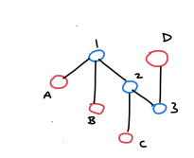
Graph Modelling 4a
Imagine you have a population in which some few people are infected with this weird virus. For any two patients, you want to decide whether the infection might have spread from one to the other via some intermediate asymptomatic patients. You suspect that if such a path exists, it isn’t too long (since most cases are not asymptomatic).
Model each person as a node
Add edges between people if they are friends or close acquaintances
Colour the sick nodes red and the healthy nodes blue
Search for a path connecting the patients that does not contain too many blue nodes

Slide 67
Graph Modelling 4a
Imagine you have a population in which some few people are infected with this weird virus.
You also have a list of locations that each of the sick people were in during the last 14 days.
Determine if any of the sick people ever met.

Slide 68
Graph Modelling 4a
Imagine you have a population in which some few people are infected with this weird virus.
You also have a list of locations that each of the sick people were in during the last 14 days.
Determine if any of the sick people ever met.
Each vertex is either a patient or a location
Each edge connects a patient and location if the patient has visited it
Check if any of the location vertices have degree > 1
This is a bipartite graph since no two patients or no two locations are connected by an edge

Slide 69
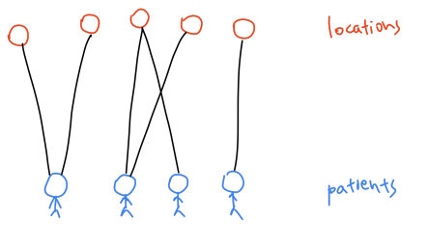
Graph Modelling 4a
Imagine you have a population in which some few people are infected with this weird virus.
You also have a list of locations that each of the sick people were in during the last 14 days.
Determine if any of the sick people ever met.

Slide 70
Graph Modelling 4b

Slide 71
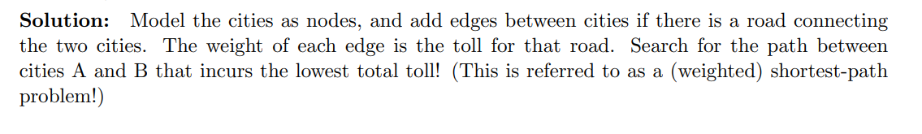
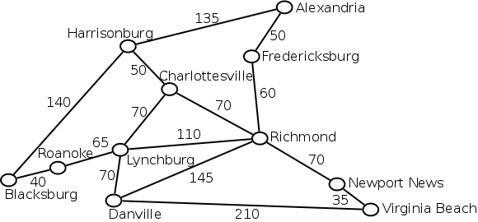

Slide 72
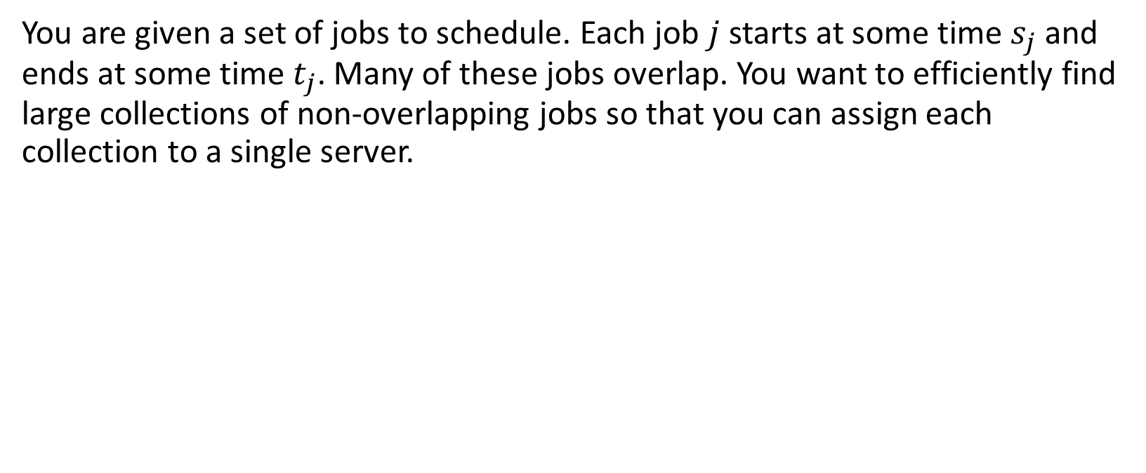
Graph Modelling 4c

Slide 73
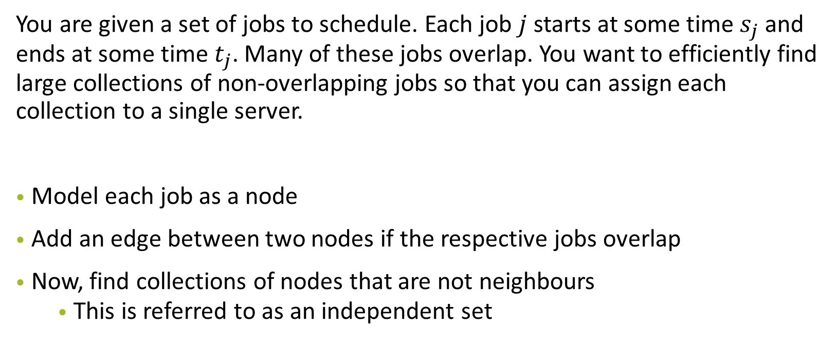
Graph Modelling 4c

Slide 74
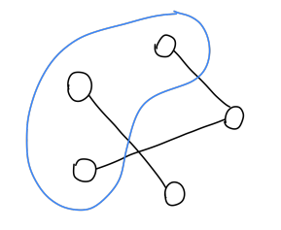
Graph Modelling 4c
Find the maximal independent set: the
largest possible subset of vertices such that
for any two vertices, there is no edge
between them

Slide 75
Graph Modelling 4d)
An English professor complains that students in their class are cheating. The professor suspects that the cheating students are all copying their material from only a few different sources, but does not know where they are copying from. Students that are not cheating, on the other hand, all submit fairly different solutions. How should we catch the cheaters?

Slide 76
Graph Modelling 4d)
An English professor complains that students in their class are cheating. The professor suspects that the cheating students are all copying their material from only a few different sources, but does not know where they are copying from. Students that are not cheating, on the other hand, all submit fairly different solutions. How should we catch the cheaters?
Model each student’s essay as a node
Add an edge between two nodes if the respective essays are similar
A cluster of nodes all connected to each other likely indicates cheating

Slide 77
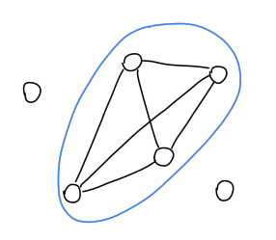
Graph Modelling 4d)
An English professor complains that students in their class are cheating. The professor suspects that the cheating students are all copying their material from only a few different sources, but does not know where they are copying from. Students that are not cheating, on the other hand, all submit fairly different solutions. How should we catch the cheaters?
Find a clique: a subset of vertices such that
for any two vertices, there is an edge
between them

Slide 78
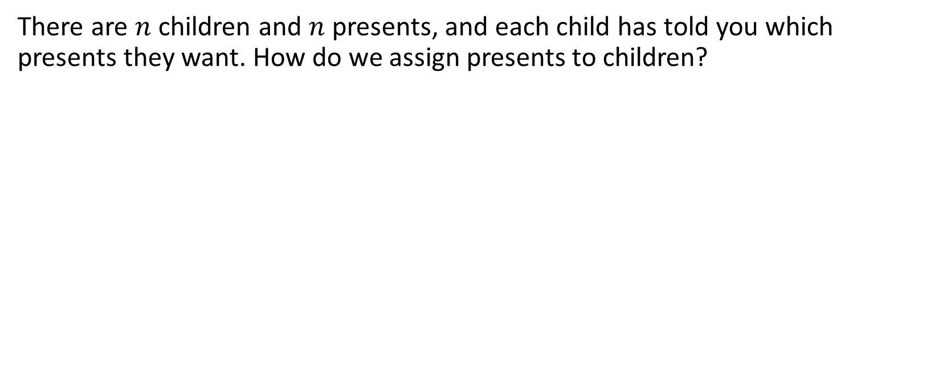
Graph Modelling 4e)

Slide 79
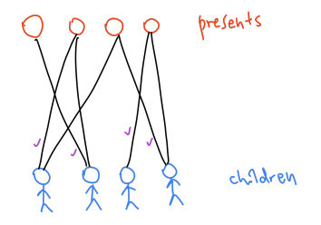
Graph Modelling 4e)
Find a matching: a subset of edges such that none of them share any endpoints

Slide 80
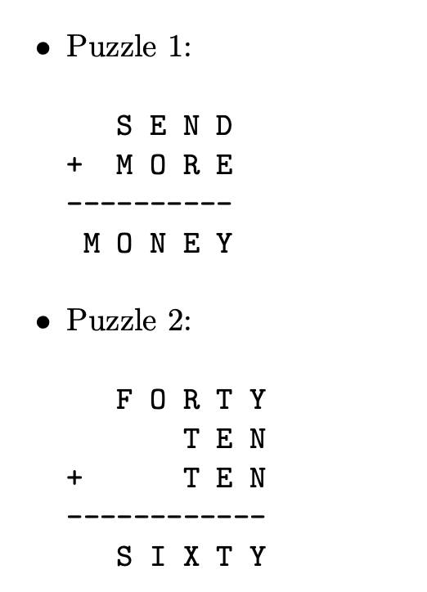
Problem 5a)
Explain how to model the problem as a graph search problem.

Slide 81
Problem 5a)
Node:
Edges:

Slide 82
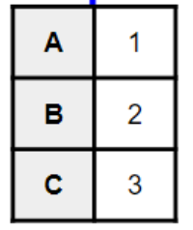
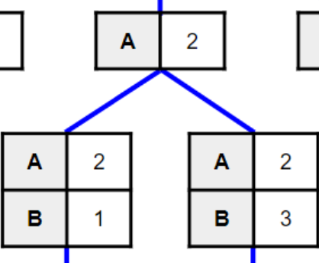
Problem 5a)
Node: Assignments
Edges: Assigning one more letter
I.e. 2 nodes are connected by an edge if one node is the result of assigning one more letter to the previous node

Slide 83
Problem 5a)
Start node:
Goal:

Slide 84
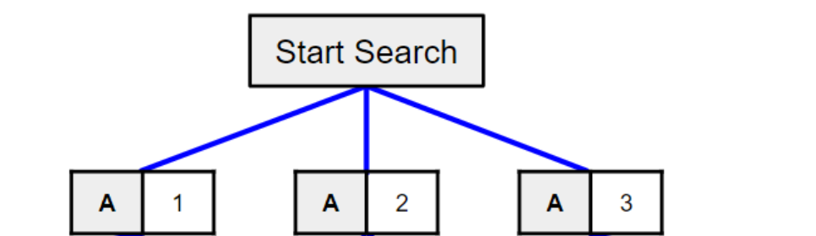
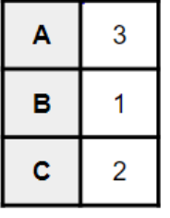
Problem 5a)
Start node: Nothing assigned
Goal: All letters assigned and node is valid (no constraint is violated)
E.g. For A - B = C
Goal would be

Slide 85
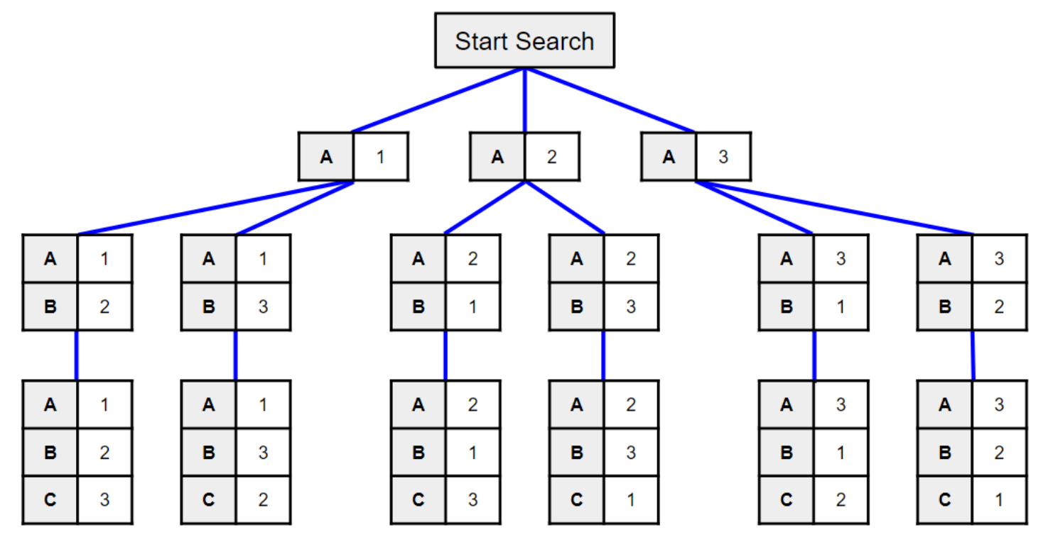
Problem 5a)

Slide 86
Problem 5a)
How many nodes?

Slide 87
Problem 5a)
How many nodes?
n! , n is the number of unique letters
10! in worst case as only 10 digits available

Slide 88
Problem 5b)
DFS or BFS?

Slide 89
Problem 5b)
DFS or BFS?
We don’t have to search the entire tree, just find a single legal assignment of all letters
Asymptotically (i.e. worst case), there is no difference in using DFS or BFS

Slide 90
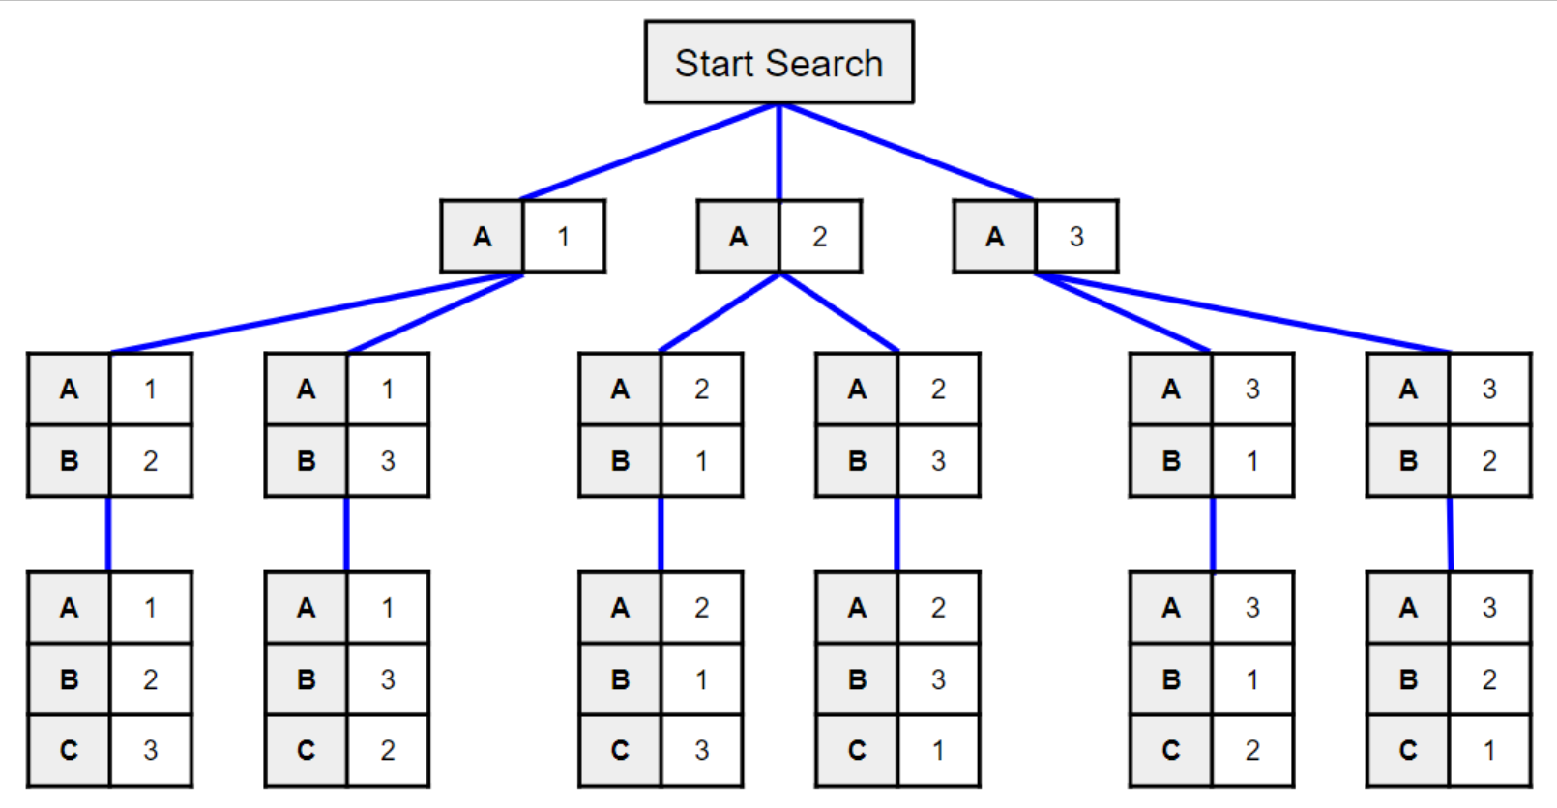
Problem 5b)

Slide 91
Problem 5b)
If this is a possible solution, can return this and stop searching further

Slide 92
Problem 5b)
If this is a possible solution, can return this and stop searching further

Slide 93
Problem 5b)
Worst case still searches through everything

Slide 94
Problem 5b)
What do you observe about this graph?

Slide 95
Problem 5b)
What do you observe about this graph?
Tree

Slide 96
Problem 5b)
How to make it run faster?
Heuristics
The choice of which variable to assign first, which value to assign to a variable first can help invalidate large subtrees earlier (pruning)
Save on wasteful computation

Slide 97
Problem 5b)
How to make it run faster?
Heuristics
More on this: take CS2109 Introduction to AI and ML. Interesting if you like graph algorithms (a lot of it has been taught by 2040s like game trees)
First few weeks are basically what you learn here: tree-search version of BFS and DFS. And you get to learn the A star algorithm (a better version of Dijkstra’s) which is really cool 100% recommend if you like CS2040s
Create heuristics which was quite fun - our midterms were about creating a heuristic for this problem!

Slide 98
Problem 5c)
When does your search finish? Can you optimize the algorithm to minimize the amount of searching?

Slide 99
Problem 5c)
At every node, check if partial assignment is valid:
Sum every column of the equation (and potential carry) and determine whether it’s correct
If valid: Continue searching down the node (aka continue making assignments)
If not valid: Stop DFS along down the subtree of this node (aka stop exploring and making assignments)

Slide 100
Problem 5c)
Constraint-satisfaction problem (CSP) which you will see in CS2109S Introduction to AI and ML
Key learning point: How to model a problem with graphs

Slide 101
Problem 6)
We have to divide students into good and bad. Tutors each create a set of cards. Each card contains the names of two students. One of the two names is a good student, and the other is a bad student. Unfortunately, they do not indicate which is which.
It is not certain that the cards are consistent: maybe one tutor thinks that Humperdink is a good student, while another tutor thinks that Humperdink is a bad student. (And Humperdink may appear on several different cards.) In addition, the tutors do not provide cards for every student.
Assume you can read the names on a card in O(1) time and that there are more good students than bad students.

Slide 102
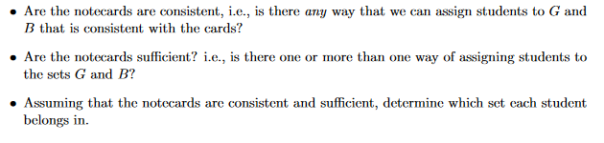
Problem 6)
We have to divide students into good and bad. Tutors each create a set of cards. Each card contains the names of two students. One of the two names is a good student, and the other is a bad student. Unfortunately, they do not indicate which is which.
Assume you can read the names on a card in O(1) time and that there are more good students than bad students.

Slide 103
Problem 6)
Node: Students (Alice, Bob, Charlie, Demon, Elliot)
Alice
Bob
Edges: Students that are on the same card are connected by an edge

Slide 104
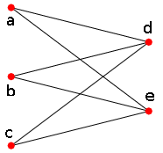
Problem 6)
If the cards are consistent, our graph will look something like this:
Alice
Demon
Bob
Elliot
Charlie

Slide 105
Problem 6)
If the cards are consistent, our graph will look something like this:
Alice
Demon
Elliot
Bipartite graph
Essentially, we want to find out if our graph is bipartite
Bob
Charlie

Slide 106
Problem 6)
This can be modelled as an AI search problem:
Graph coloring - an NP complete problem
If the notecards are consistent, then you should be able to color the graph with two colors (e.g. green and blue) such that for every edge, one node must be green and one node must be blue

Slide 107
Consistent example
Alice
Demon
Alice
Eliot
Eliot
Charlie
Demon
Charlie
Demon
Bob
b
a
d
e
c

Slide 108
Consistent example
Alice
Demon
Alice
Eliot
Eliot
Charlie
Demon
Charlie
Demon
Bob
b
a
d
e
c

Slide 109
Consistent example
Alice
Demon
Alice
Eliot
Eliot
Charlie
Demon
Charlie
Demon
Bob
b
a
d
e
c

Slide 110
Consistent example
Alice
Demon
Alice
Eliot
Eliot
Charlie
Demon
Charlie
Demon
Bob
b
a
d
e
c

Slide 111
Inconsistent example
Alice
Demon
Alice
Eliot
Eliot
Charlie
Bob
Charlie
Demon
Bob
b
a
d
e
c

Slide 112
Problem 6)
Is there more than one way to assign students to good/bad?

Slide 113
Problem 6)
Is there more than one way to assign students to good/bad?
Connected graphs: No, only one way (i.e. sufficient). We use this info:
“there are more good students than bad students.”
→ Color with more nodes: represents “good”

Slide 114
Problem 6)
Is there more than one way to assign students to good/bad?
What if we have multiple connected components?

Slide 115
Problem 6)
Is there more than one way to assign students to good/bad?
What if we have multiple connected components?
Alice
Demon
Demon
Bob
Eliot
Charlie
d
b
a
e
c
c
e
How to assign? We don’t know

Slide 116
Problem 6)
Is there more than one way to assign students to good/bad?
Sufficiency: depends on whether our graph is connected

Slide 117
Problem 7) Gone viral
There are n students in the National University of Singapore. Among them, there are n − 1 friendships. Note that friendship is a symmetric relation, but it is not necessarily transitive. Any two people in the National University of Singapore are either directly or indirectly friends. It was discovered today that two people were found to have the flu in the National University of Singapore. Every day, every person can meet with at most one friend. When these two people meet, if exactly one of them has the flu, it will be transmitted to the other.
Give an O(n log² n) algorithm to determine the minimum possible number of days before it is possible that everyone has the flu.
Hint: First, solve the case where there is only a single person was infected at the start in O(n log n).

Slide 118
Problem 7) Gone viral
What type of graph is this?
Tree
There are n students in the National University of Singapore. Among them, there are n − 1 friendships. Note that friendship is a symmetric relation, but it is not necessarily transitive. Any two people in the National University of Singapore are either directly or indirectly friends (connected graph). It was discovered today that two people were found to have the flu in the National University of Singapore. Every day, every person can meet with at most one friend. When these two people meet, if exactly one of them has the flu, it will be transmitted to the other.
Give an O(n log² n) algorithm to determine the minimum possible number of days before it is possible that everyone has the flu.
Hint: First, solve the case where there is only a single person was infected at the start in O(n log n).

Slide 119
Problem 7)
Node:
Edges:

Slide 120

Problem 7)
Node: Students
Edges: Friendship
(A and B are connected by an edge if they are friends)

Slide 121
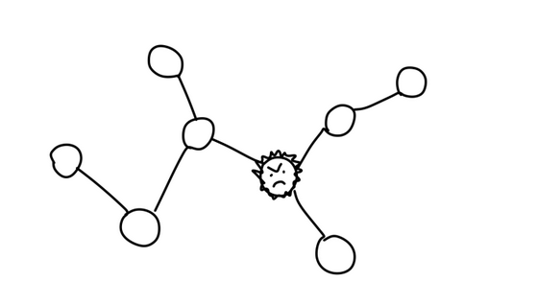
Problem 7)
Suppose 1 infected student

Slide 122
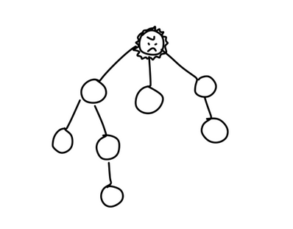
Problem 7)
Model him as the root of the tree

Slide 123
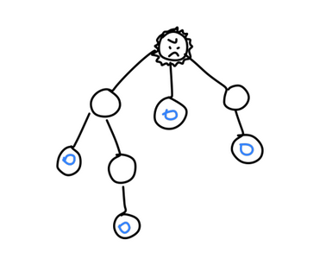
Problem 7)
Let f(x) be the minimum number of days before all of x’s children get infected after x got infected

Slide 124
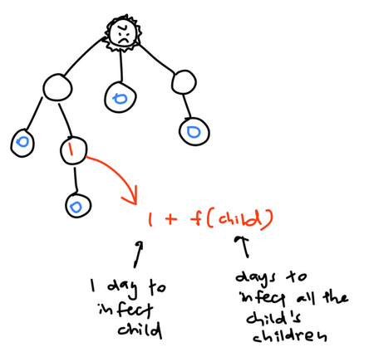
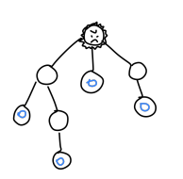
Problem 7)
Let f(x) be the minimum number of days before all of x’s children get infected after x got infected

Slide 125
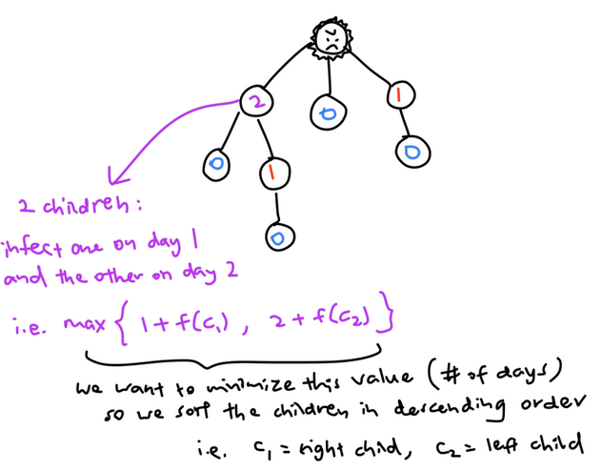
Problem 7)
Let f(x) be the minimum number of days before all of x’s children get infected after x got infected

Slide 126
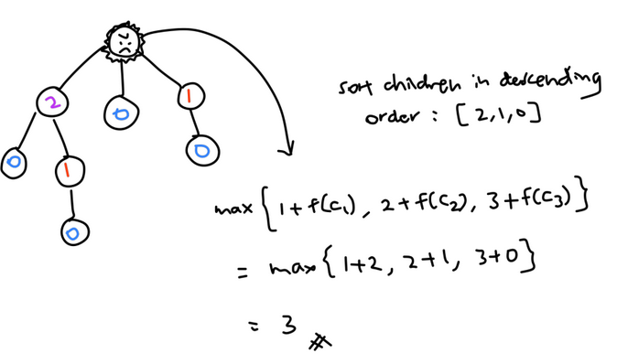
Problem 7)
Let f(x) be the minimum number of days before all of x’s children get infected after x got infected

Slide 127
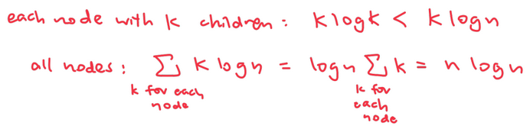
Problem 7)
In general, if x has k children, it takes O(klogk) time to sort the children by their f(c) value before calculating the max
Therefore for 1 node it takes O(klogk)
Using Maths, you get that it takes O(nlogn) in total:

Slide 128
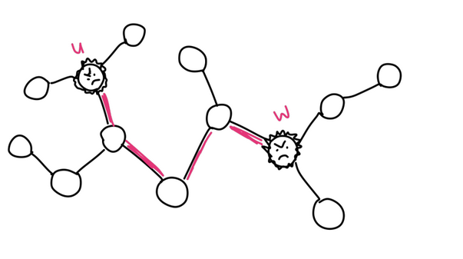
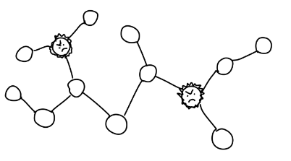
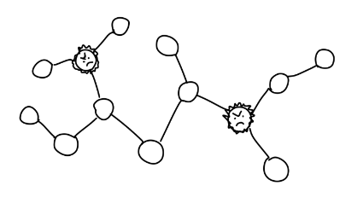
Problem 7)
Suppose there are 2 infected students

Slide 129
Problem 7)
There is a unique path u, v1,..vt between them (since it is a tree)

Slide 130
Problem 7)
We can split the graph into two at some edge along this path such that each student infects everyone in their own component

Slide 131
Problem 7)
But where do we split?
Halfway may not always be the best due to branches

Slide 132
Problem 7)
• Idea: binary search on where to split along the path (1 to t)
• Run the one infected student algorithm on both sides
• If f(u) < f(w), we can afford to put more vertices into the u component
• Since max path length is n, binary search takes O(logn) time x O(nlogn) algorithm at each level
O(nlogn logn)!! YAY

Slide 133
Problem 7): Gone vial
My friend’s slides; feel free to read

Slide 134

Problem 7): Gone viral
We want to find f(x) of root
Let f(x) = days needed for all nodes in the subtree at x to be infected
Leaf nodes
f(x) = 0

Slide 135
Problem 7): Gone viral
Let f(x) = days needed for all nodes in the subtree at x to be infected
Internal nodes:
f(x) = max(f(A) + 1, f(B) + 2) or max(f(B) + 1, f(A) + 2)
A
B
Leaf nodes
f(x) = 0

Slide 136
Problem 7): Gone viral
Internal nodes:
f(x) = max(f(A) + 1, f(B) + 2) or max(f(B) + 1, f(A) + 2)
Let f(x) = days needed for all nodes in the subtree at x to be infected
We want to minimise f(x) so we should sort f(c₁), f(c₂), …, f(c_{n})
c₁, c₂, …c_{n} ⇒ Children of node x
Largest f(c_{i}) + 1, 2nd largest + 2 … etc.
A
B

Slide 137
Problem 7): Gone viral
We want to minimise f(x) so we should sort f(c₁), f(c₂), …, f(c_{n})
c₁, c₂, …c_{n} ⇒ Children of node x
Largest f(c_{i}) + 1, 2nd largest + 2 … etc.
Time complexity?

Slide 138
Problem 7): Gone viral
We want to minimise f(x) so we should sort f(c₁), f(c₂), …, f(c_{n})
c₁, c₂, …c_{n} ⇒ Children of node x
Largest f(c_{i}) + 1, 2nd largest + 2 … etc.
Time complexity?
O(k log k) for an internal node with k children
-> Overall: O(nlogn)

Slide 139
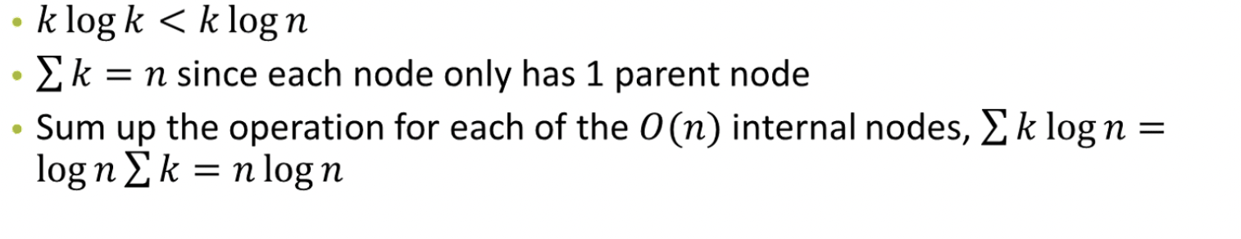
Problem 7): Gone viral
We want to minimise f(x) so we should sort f(c₁), f(c₂), …, f(c_{n})
c₁, c₂, …c_{n} ⇒ Children of node x
Largest f(c_{i}) + 1, 2nd largest + 2 … etc.
Time complexity?
O(k log k) for an internal node with k children
-> Overall: O(nlogn)

Slide 140
Problem 7): Gone viral
We can split this path into nodes infected by A and nodes infected by B
…
B
A

Slide 141
Problem 7): Gone viral
We can split this path into nodes infected by A and nodes infected by B
If tree containing A needs more days to infect all nodes, should assign more nodes along this path to be infected by B.
…
B
A

Slide 142
Problem 7): Gone viral
We can split this path into nodes infected by A and nodes infected by B
How to find this split? Binary search along this path
max path length is n: binary search = O(logn)
Performance: O(nlog²n)
…
B
A

